Slide 1
Database Design Fundamentals
Louis Davidson
drsql.org

Slide 2















Visibility Across the Microsoft Data Platform
Our products at a glance
SQL Sentry Monitor, diagnose and optimize SQL Server Performance.
Plan Explorer SQL plan analysis and advanced query tuning.
CodeSlice SSIS script development and sharing.
DBA xPress Inspect and compare schemas, objects, and data.
DEVELOPMENT
Task Factory Drive Productivity with 60+ SSIS components for connectivity, execution performance, and security.
APS Sentry See performance for Microsoft Analytics Platform System, data movement and queries.
BI Sentry Find and fix SSAS performance problems.
Win Sentry Boost Windows Server and Hyper-V virtualized environment performance.
BI
BI xPress SSIS and SSRS Monitoring and package deployment in Visual Studio.
V Sentry Monitor resource utilization (memory, CPU, network, storage) of VM environments.
OPERATIONS
DW Sentry Accelerate Azure SQL Data Warehouse performance with visibility into workload impacts.
DB Sentry Keep Azure SQL Databases running at peak efficiency with metrics and DTU usage.
Workbench Server Combines Doc xPress Server, BI xPress Server and LegiTest Server.
ADMINISTRATION
DOC xPress Automatic documentation, object lineage, impact analysis, data dictionary and environment compare.
Weekly Public Demos
www.sentryone.com/public-demo
LegiTest Automated data-centric application testing and data verification.

Slide 3

Free Resources
More training and education
Courses.SentryOne.com expansive CBT program to learn all the ins and outs of the S1 product line.
Docs.SentryOne.com full product documentation.
SQLPerformance.com provides innovative and practical solutions for improving SQL Server performance.
SentryOne.com/Resources offers an inside look into the world of SentryOne with videos on query tuning and product demos, white papers, ebooks, case studies and tech briefs.
Blogs.SentryOne.com is where you can find all of our team members’ blogs as well as important information about the latest updates to SentryOne software, SQL Server and server performance issues.

Slide 4


Presenters
Who we are
Kevin Kline
Principal Program Manager, SentryOne
https://www.sentryone.com/blog/author/kevin-kline
https://twitter.com/kekline
kkline@SentryOne.com
https://LinkedIn.com/in/kekline
Louis Davidson
Data Architect for CBN
louis@drsql.org
http://drsql.org
http://twitter.com/drsql

Slide 5
Agenda
Introductions
Pre-Design Tasks
Design Process Tasks
Modeling: Conceptual ➔Logical ➔Physical
Validation Process Tasks
Wrap-up and Q&A
✓
✓
✓
✓

Slide 6
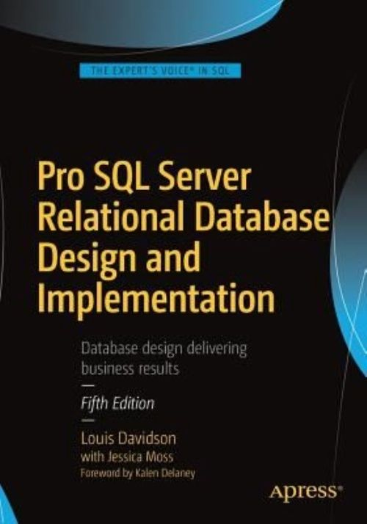
Who am I?
Been in IT for 20-some years
Microsoft MVP 14 Times
Corporate Data Architect
Written 6 books on database design
They were technically all versions of the same book.
They at least had slightly different titles each time
Super Brief Contact Info: DRSQL
Twitter, Website (.org), Email (@hotmail.com)
Notes:
Change it to planning the next version

Slide 7


The two reasons we build databases
This Photo by Unknown Author is licensed under CC BY

Slide 8
Pre-Design Tasks
Think: What problem are we really trying to solve?
Communicate: Get agreement from all involved that you are solving the right problem
Users
Management
Project
Client
Programmers
Anyone else who might disagree with you and cause your design harm later. (other than your significant other, unless you work together.)
The common term for what you need is Requirements

Slide 9

Requirements are like Family Vacation Plans
If everyone decided on Lake Eerie (instead of Erie), then everyone is to blame

Slide 10
WRITE REQUIREMENTS DOWN
WRITE IT DOWN. Seriously.
True for Agile, Extreme, or Full Blown Committee Driven Waterfall
Use to provide the target for the rest of the project
Design
Coding
Testing
Make certain you get sign-off from all decision makers
Anything not written down can and will change without notice
WRITE IT DOWN. Before you code. I mean it.

Slide 11

Design goal
A database that works well, and meets your needs, and doesn’t lie to you more than you expect it to…
…and (if so determined to be something that needs the guarantees of the relational engine) within the constructs of the relational engine

Slide 12
Prerequisites
There are no variations except for those who know a norm, and no subtleties for those who have not grasped the obvious.
C. S. Lewis, An Experiment in Criticism

Slide 13
Prerequisites Relational History/Theory
Codd’s Rules
13 Rules that qualified a system as a “relational” database system, written back in 1985 (I was in high school)
Will help you see the thought process behind how products like SQL Server are implemented
Outlines aspects of RDBMS, including: Catalog; Data Access (and a lack of direct physical access); NULLs; Integrity controls; Set based operations
Basic relational theory
Trade books
Textbooks
College classes

Slide 14
Database Design Process
Conceptual
Early model, generally representing the tables or things being modeled and their relationship to each other
Logical
Ideal representation of the problem that is trying to be solved. Generally the “complete” data requirements
Physical - Code
Represents what is actually implemented
Physical - Hardware Interface
The on-disk structures (engine (on disk, in mem, etc) indexes, partitions, distribution, etc) that ideally have no bearing on anything other than performance
Code is largely developer based, hardware interface is largely DBA focused…
These layers correspond loosely to deliverables called data models
Notes:
Remove layer from bullet

Slide 15
What does it mean to data model?
Design and capture the semantic details of the database
Including
Structure
Predicates
Documentation
May include more than can be implemented
Most modeling languages have a graphical representation that makes communication easier
A picture is worth a thousand words when communicating with non-modelers
Notes:
May include more than can be implemented

Slide 16
Start with the Conceptual Model
Start by understanding the requirements
Build a Conceptual Model
Tables (Nouns)
Relationships (Connective sentences/phrases)
Validate (Test) the model against the requirements
If YES (they do) Move On To Logical Model
If NO, Keep Trying
Notes:
Title Get started with the..

Slide 17
Example Model
The next slides walk us through the stages of a small modeling project
High Level Requirements:
Messaging system for conference attendees
Can send message to everyone or one person
Messages can have multiple topics chosen from a fixed set of topics (but you can create a custom topic as well)
No duplicate messages in the same hour
Attendees can be connected to other attendees
Messages must not include bad language or “hate” speech

Slide 18

Example Model
Messaging system for conference attendees

Slide 19
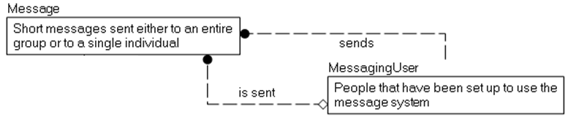
Example Model
Messaging system for conference attendees
Can send message to everyone or one person

Slide 20
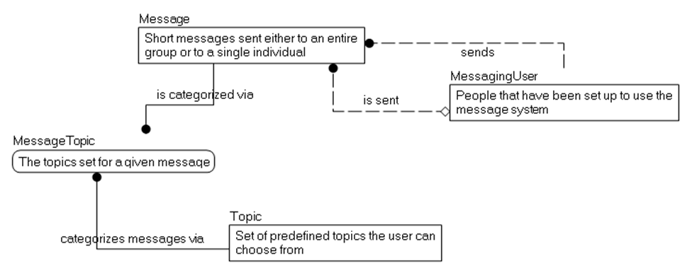
Example Model
Messaging system for conference attendees
Can send message to everyone or one person
Messages can have multiple topics chosen from a fixed set of topics (but you can create a custom topic as well)

Slide 21
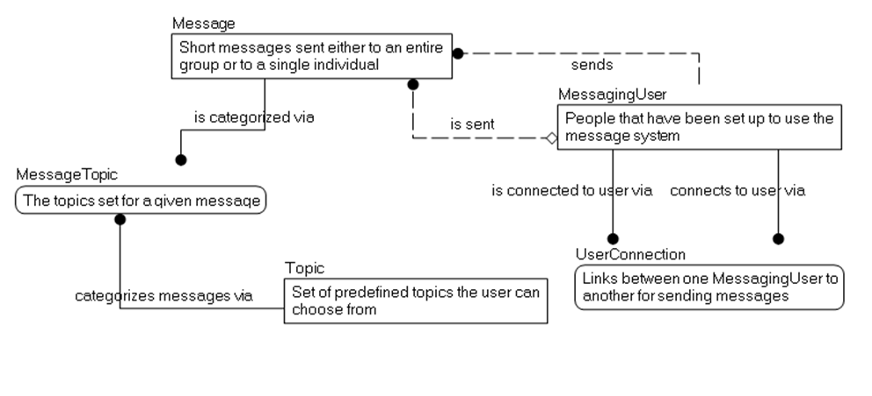
Example Model
Messaging system for conference attendees
Can send message to everyone or one person
Messages can have multiple topics chosen from a fixed set of topics (but you can create a custom topic as well)
No duplicate messages in the same hour
Attendees can be connected to other attendees

Slide 22
Example Model
Messaging system for conference attendees
Can send message to everyone or one person
Messages can have multiple topics chosen from a fixed set of topics (but you can create a custom topic as well)
No duplicate messages in the same hour
Attendees can be connected to other attendees
Messages must not include bad language or “hate” speech

Slide 23
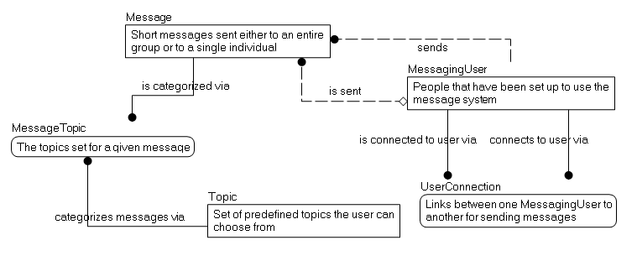
Final Conceptual Model
Tables, with descriptions and relationships
Test against the requirements (Looks like the process we just went through, with edits)

Slide 24
Continue to the Logical Model
Columns (With legal values-domain)
Uniqueness conditions (Keys)
System Predicates
Basically: Understand what is good data, and what is NOT good data.
It doesn’t matter how any of this can be implemented with or without SQL
Continue to test your design against the requirements
If YES (they do), start moving towards building tables (Woo hoo!)
If NO, keep refining the model
Notes:
Title Get started with the..

Slide 25
Tip – Start Out Naming Consistently
There are lots of naming standards out there.
Most importantly, name consistently
Names should be as specific as possible
Data should rarely be represented in the name
Don’t use the English language as a guide (I before E except after C, unless?)
Early in the process, avoid abbreviations unless it is very apparent to everyone
When you build the physical model, if you must abbreviate, use a data dictionary to make sure abbreviations are always the same
Tables
Never prefixed to says that this is a table (tbl_TableName)
Singular or Plural (either one)
I prefer singular

Slide 26
Column Naming
Column names should be singular - Columns should (at least eventually) represent a scalar value
Avoid overly specific prefixes/suffixes
Follow a standard format for names
An example that I have seen documented in various places (often attributed to ISO 11179) is to have names that include something along the following:
RoleName – Optional for when you need to explain the purpose of the attribute
Attribute – The primary purpose of the column being named. Optionally can be omitted, meaning it refers to the entity
Classword – a suffix that identifies the usage of the column, in non-implementation specific terms
Scale – Optional to tell the user what the scale of the data is, like minutes, seconds, dollars, euros, etc
RoleName_Attribute_Classword_Scale

Slide 27
Column Naming Examples
Name - a textual string that names the row value, but whether or not it is a varchar(30) or nvarchar(128) is immaterial (prefix is implied. Example Company.Name)
UserName - a more specific use of the name classword that indicates it isn’t a generic usage
AdminstratorUserName – A user name, but specifically for the admin user.
PledgeAmount - an amount of money (using a numeric(12,2), or money, or any sort of types)
PledgeAmountEuros - an amount of money (using a numeric(12,2), or money, or any sort of types), but with an atypical scale
TickerCode - a short textual string used to identify a ticker row
EndDate - the date when something ends. Does not include a time part
SaveTime - is the point in time when the row was saved
MailIsHereFlag – the mail delivery person has put the flag up, and your mail is here (your IOT device has discovered and told you)

Slide 28
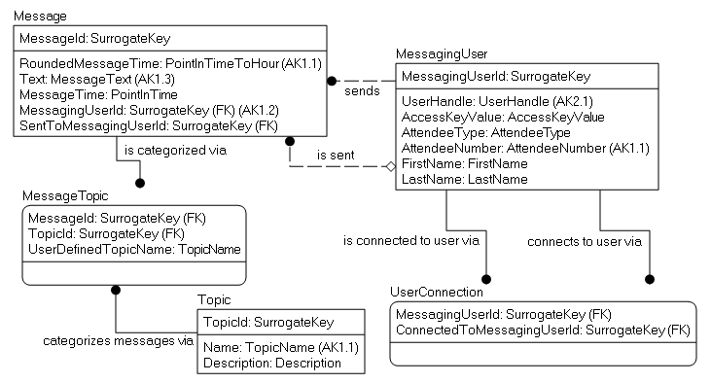
Logical Model
Name: Message
Description: Short messages sent either to an entire group, or to a single individual
Predicates: A message with the same text may only be sent once per hour by the same sender
The “ideal” version of the database requirements
Implementation non-specific

Slide 29
Logical Model Basics - Domains
Name: MessageText
Description: Used to present messages to users
Type of Data: unformatted values, less than or equal to 200 characters
Predicates: Must not be empty or Null, Must not include hate speech, bad language, etc.
Name: PointInTimeToHour
Description: Used to capture the hour of a day when something occurred, probably to limit an action to one an hour
Type of Data: point in time, rounded to nearest hour
Predicates:
Name: SurrogateKey
Description: Used as a stand-in for the natural key
Type of Data: Any
Predicates: The data should be of some format that is small, yet still sufficiently capable of being unique
Domains instead of Data types
Domains should define the domain of values that can be used
Data types will specify part of how the domain is implemented
Check constraints, triggers etc may also be needed to do the implementation

Slide 30
Logical Model Basics - Relationships
Example: If you want to cascade operations on two relationships, this cannot be built as two cascading foreign key constraints
Document all relationship requirements, no matter how you will need to implement them

Slide 31
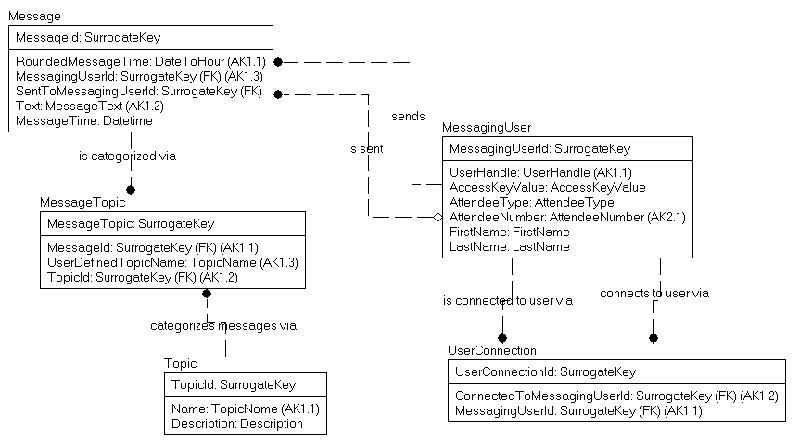
Surrogate Keys on all Tables?
This has a few effects, positive and negative
Positive: it is very similar to what UI tools often expect
Keeps personal information out of keys (that might end up on a web page call!)
Negative: Uniqueness and lineage are more difficult to see

Slide 32
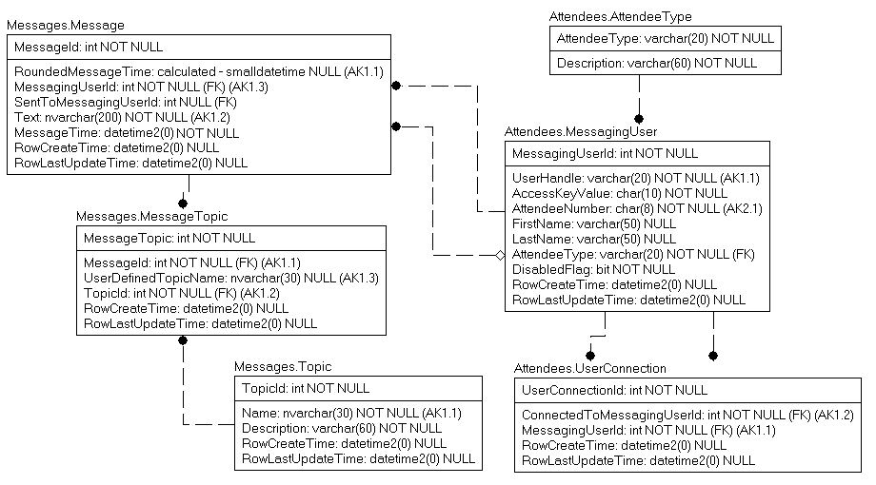
Physical Model
Domain table, added to implement a domain
“Physical” columns added, like RowCreateTime, RowLastUpdateTime
Schemas implemented to segregate tables into “families” for usage/security purposes
Some domains become tables
Best data types chosen

Slide 33
Document
Every table and column should have a succinct description
Then expand complex situations with documents, examples, etc, with the knowledge that will likely not be maintained…
Try to avoid too many examples, as data can change
Ideally, the documentation will be accessible by programmers and end users alike

Slide 34
Are we done yet?
Perhaps
At this point, it is important to check your model against a standard
For a relational database, the standards are the Normal Forms

Slide 35
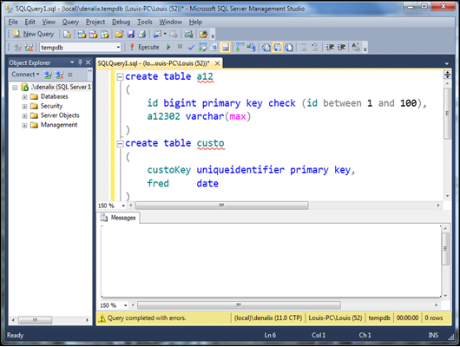
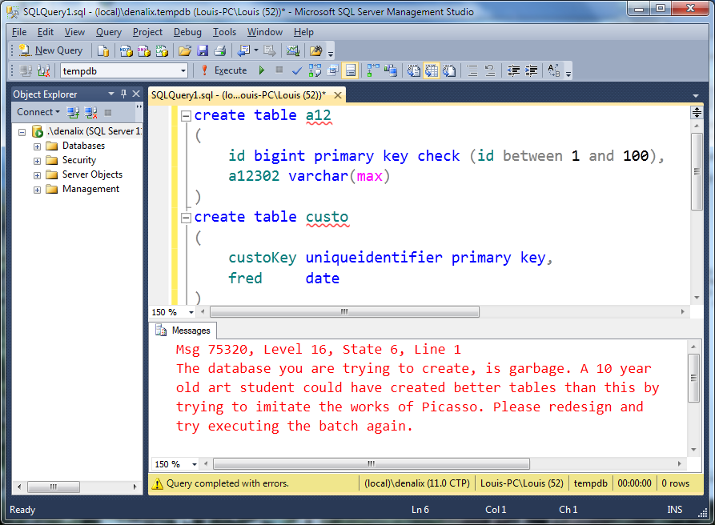
New SQL Server ‘19 Design Assistance Warning Message
Press Ctrl-Y, Ctrl-R
Oh, wait, I think this is SQL Server 3019… Until then, we have to do this work on our own.

Slide 36
Normal Forms/Normalization
A process to shape and constrain your design to work with a relational engine
Specified as a series of forms that signify compliance
A definitely non-linear process.
Used as a set of standards to think of compare to along the way
After practice, normalization is mostly done instinctively

Slide 37
Normalization Main Purpose
Eliminate DML modification anomalies
Meaning, you update one value:
One piece of data is changed
No other piece of data needs changing
Normalization is focused around protecting the integrity of your data by
Making every column and table an atomic unit
Making modifications atomic operations
Guaranteed atomicity of operations is a big part of the what makes relaxational databases important

Slide 38

Atomicity
At the lowest level possible without losing the original characteristics
Similar to context of physics as we know it in the 21st century
Break down H²0 into Hydrogen and Oxygen, no big deal
Break down Hydrogen it becomes a different sort of matter and you are going to need a new laboratory
This Photo by Unknown Author is licensed under CC BY-SA

Slide 39
Keep Your Design Simple
Meet the user’s requirements to the Normal Form’s requirements
One table per user’s concept
One column per user’s attributes of that concept
Things it is not:
Religion
Complicated
Easy
Proper designs answer all user queries in straightforward SQL

Slide 40
Normal Forms Overview - 1NF
Basic shaping of data for the engine
Data broken down to it’s lowest form
Column Values are atomic
No duplicate rows
All rows must represent the same number of values (Sometimes referenced as “no repeating groups”)
Notes:
SQL works the way SQL works.
<click>
First normal form basically sets up that
Rows are unique
Columns contain just one value (I like to think of this as one value at the lowest form that I will use in SQL. So if I ever need to display phone numbers for a give area code, then I have an area code attribute no matter what)
No columns like Value1, Value2, Value3, where Value1 might be filled in, but not value2 and/or 3. Bloody awful this is. (I have a term coined for this situation in a minute)
<click>
This is the most important normal form, and ANY table in SQL should follow it (XML is an exception, in a way…might make some reference to XML here and how I feel about it)

Slide 41
Your database may not be in 1NF if..
You have string data that contains separator-type characters. Example, patterns using commas, pipes, tildes, etc (even spaces can qualify)
Bitmasks (ew!)
Attribute names with numbers at the end
Payment1, Payment2, …
Tables with no or poorly defined keys
CustomerId int identity PRIMARY KEY

Slide 42
First Normal Form Example 1
Requirement: Table of school mascots
To truly be in the spirit of 1NF, some manner of uniqueness constraint needs to be on a column that has meaning
It is a good idea to unit test your structures by putting in data that looks really wrong and see if it stops you, warns you, or something!
~~~~~~~~~~~ ~~~~~~~~~~~
MascotId Name =========== ----------- 1 Smokey 112 Smokey 4567 Smokey 979796 Smokey
Color -----------
Black/Brown Black/White Smoky Brown
School -----------
UT Central High Less Central High Southwest Middle

Slide 43
Uniqueness isn’t always naturally attainable
Design for all possible cases, even if you will not be able to implement solely in SQL Server
Some common uniqueness requirements
Bulk Uniqueness – Inventory of Canned Goods, Parts, etc.
One row per type of object
Selective Uniqueness – Unique when filled in: Driver’s License Number, SSN/Work Number, Union Card Number
Use a unique filtered index (2008+), indexed view (2000- 2005) or triggers (earlier) to implement
Likely Uniqueness – Data condition where a human should make the decision about uniqueness: Employee names; Customer Information, etc.
Bottom Line: Design all uniqueness situations, enforce as much as possible (and reasonable).

Slide 44
First Normal Form Example 2
Requirement: Store information about books
What is wrong with this table?
Lots of books have > 1 Author.
What are common way users would “solve” the problem?
Any way they think of!
What’s a common programmer way to fix this?
BookISBN BookTitle BookPublisher Author
=========== ------------- --------------- -----------
111111111 Normalization Apress Louis 222222222 T-SQL Apress Michael 333333333 Indexing Microsoft Kim 444444444 DB Design Apress Jessica
, Louis
and Louis
& Louis
444444444-1 DB Design Apress Louis

Slide 45
First Normal Form Example 2
Add a repeating group?
What is so wrong?
BookISBN BookTitle BookPublisher …
=========== ------------- ---------------
111111111 Normalization Apress … 222222222 T-SQL Apress … 333333333 Indexing Microsoft … 444444444 Design Apress …
Author1 Author2 Author3
----------- ----------- -----------
Louis Michael Kim Jessica Louis

Slide 46
First Normal Form Example 2
Two tables!
And it gives you easy expansion
BookISBN BookTitle BookPublisher
=========== ------------- ---------------
111111111 Normalization Apress 222222222 T-SQL Apress
333333333 Indexing Microsoft 444444444 DMV Book Simple Talk
BookISBN Author
=========== =============
111111111 Louis 222222222 Michael 333333333 Kim 444444444 Jessica
ContributionType
----------------
Principal Author
Principal Author
Principal Author
Contributor
Principal Author
444444444 Louis

Slide 47
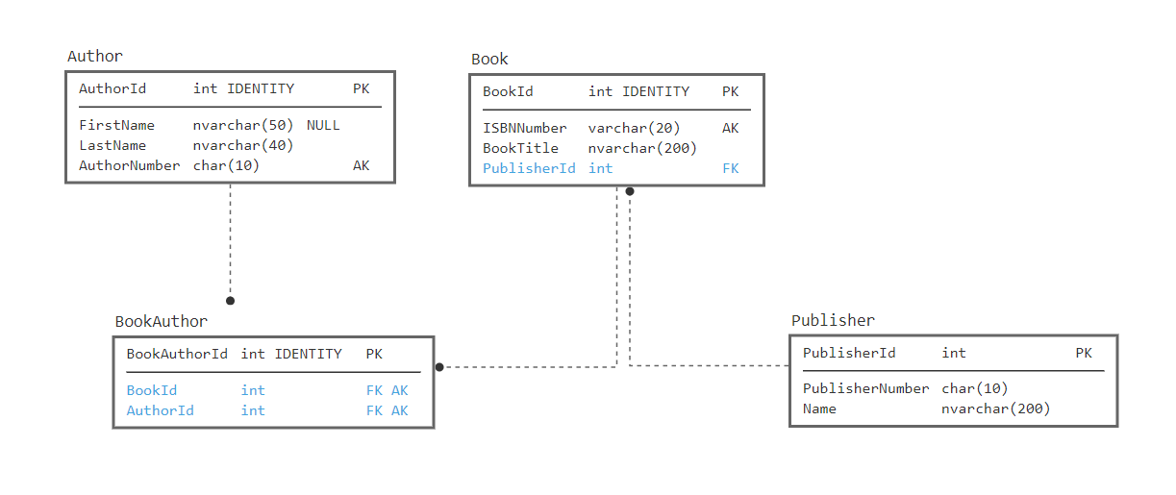
First Normal Form Example 2

Slide 48
First Normal Form Example 2.1
Email1 Email2 Email3
--------- --------- -----------
But inevitably, requirements change, and the structures are inadequate… and unchangeable… So you do something like this (and yes, I had to do this recent enough it still makes me a bit ill…that db has more columns than this!):
Email1Status Email1Type Email1PrivateFlag
------------ ------------ -------------------
Email2Status Email2Type Email2PrivateFlag
------------ ------------ -------------------
Email3Status Email3Type Email3PrivateFlag
------------ ------------ -------------------

Slide 49
First Normal Form Example 3
Requirement: Store users and their names
How would you search for someone with a last name of Nielsen? David? Davidson?
What if the name were more realistic with Suffix, Prefix, Middle names?
UserId UserName PersonName
=========== ~~~~~~~~~~~~~~ ---------------
1 Drsql Louis Davidson
2 Kekline Kevin Kline
3 Datachix2 Audrey Hammonds 4 PaulNielsen Paul Nielsen

Slide 50
First Normal Form Example 3
Break the person’s name into individual parts
This optimizes the most common search operations
It isn’t a “sin” to do partial searches on occasion, just don’t make it habitual:
I know the last name ended in “son” or “sen”
If you also commonly need the full name available, let the engine manage this using a calculated column:
PersonFullName AS CONCAT(PersonFirstName + ' ', PersonLastName)
UserId UserName PersonFirstName PersonLastName
=========== ~~~~~~~~~~~~~~ --------------- --------------
1 Drsql Louis Davidson
2 Kekline Kevin Kline
3 Datachix2 Audrey Hammonds 4 PaulNielsen Paul Nielsen

Slide 51
Normal Forms Overview – 2NF, 3NF and Boyce-Codd (BCNF) Normal Forms
Eliminate incorrect data dependencies in your tables
All attributes are either a key, or fully dependent on a key (the whole key, and nothing but the key)
Violations usually manifest themselves as multiple column, row-wise repeating groups
In other words…
All keys for a table are identified
All columns describe that “thing” that the table is modeling
Notes:
Think of it this way. A key represents the entity that is being model. An attribute describes the entity being modeled. AND NOTHING ELSE…
Sounds simple…AND IT IS…. Just requires thinking…

Slide 52
Intrarow Dependency
If you can determine the value of one attribute X given a different attribute Y, then Y is functionally dependent on X. X is considered the determinant. Example:
Assuming this is the entire known universe. X is unique key:
Y and Z are functionally dependent on X
But, is Z is functionally dependent on Y (or vice versa)?
X | Y | Z
1 | 1 | 2
2 | 2 | 4
3 | 2 | 4

Slide 53
Your database may not be BCNF if..
There are multiple columns with the same prefix
Multiple tables have the exact same complex columns
Example: Three tables have MessageSentDate, MessageText columns
There are repeating groups of data
Particularly if > 1 column shows the repeats
There are triggers with modification statements
Some trigger use to trigger workflow can make sense, but too often it is a matter or maintaining summary/status data

Slide 54
Boyce Codd NF Example 1
Requirement: Defines the types of car(s) that a driver likes
Check the attributes against the meaning of the table
Height and EyeColor define the attributes of the driver alone
MaxWeight? The weight of vehicle for that style it is acceptable for the style of car? Or the driver? Naming is important!
Defined as: Vehicle weight for car style
Driver Car Style Height EyeColor MaxWeight
======== ================ ------- --------- ----------
Louis Station Wagon 6’0” Blue 2900
Louis Hatchback 6’0” Blue 2500
Ted Coupe 5’8” Brown 2200

Slide 55
Boyce Codd NF Example 1
Solution: 3 independent tables, 1 for driver, 1 for driver’s car style preference, 1 for driver and car style
Driver Car Style
======== ================
Louis Station Wagon
Louis Hatchback
Ted Coupe
Driver Height EyeColor
======== ------- ---------
Louis 6’0” Blue
Ted 5’8” Brown
Car Style MaxWeight
================ ----------
Station Wagon 2900
Hatchback 2500
Coupe 2200

Slide 56
Boyce Codd NF Example 2
Requirement: Driver registration for rental car company
Column Dependencies
Height and EyeColor, check
VehicleOwned, check
WheelCount, <buzz>, driver’s do not have wheelcounts
Driver VehicleOwned Height EyeColor WheelCount
======== ---------------- ------- --------- ----------
Louis Hatchback 6’0” Blue 4
Ted Coupe 5’8” Brown 4
Rob Tractor trailer 6’8” NULL 18

Slide 57
Boyce Codd NF Example 2
Two tables, one for driver, one for type of vehicles and their characteristics
Driver VehicleOwned (FK) Height EyeColor
======== ------------------- ------- ---------
Louis Hatchback 6’0” Blue
Ted Coupe 5’8” Brown
Rob Tractor trailer 6’8” NULL
VehicleOwned WheelCount
================ -----------
Hatchback 4
Coupe 4
Tractor trailer 18

Slide 58
Composite Keys - Natural PK
create table driversLicense
(
driversLicenseStateCode char(2) not null,
driversLicenceNumber varchar(40) not null,
classCode char(2) not null,
primary key (driversLicenseStateCode, driversLicenseNumber)
)
create table employee
(
employeeNumber char(10) not null primary key
driversLicenseStateCode char(2) null,
driversLicenceNumber varchar(40) null,
firstName varchar(30) not null,
middleName varchar(30) null,
lastName varchar(30) not null,
unique (driversLicenseStateCode, driversLicenseNumber)
foreign key (driversLicenseStateCode, driversLicenseNumber)
references driversLicense(driversLicenseStateCode, driversLicenseNumber)
)

Slide 59
Composite Keys – The Surrogate Effect
This is a mathematically equivalent representation
create table driversLicense
(
driversLicenseId int primary key –might be identity or even GUID
driversLicenseStateCode char(2),
driversLicenceNumber varchar(40),
classCode char(2),
unique (driversLicenseStateCode, driversLicenseNumber)
)
create table employee
(
employeeId int identity primary key, –might be identity or even GUID
employeeNumber char(10) not null unique,
driversLicenseId int null unique references driversLicense(driversLicenseId)
firstName varchar(30) not null,
middleName varchar(30) null,
lastName varchar(30) not null
)

Slide 60
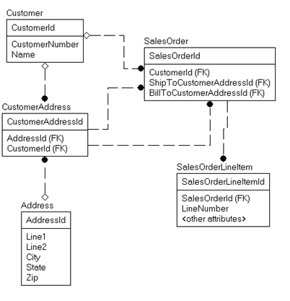
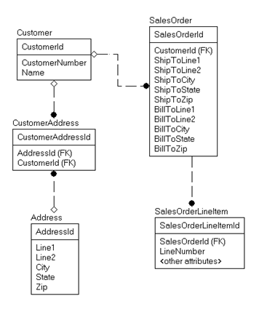
Quiz – Which Model is Correct?
Or
A
B

Slide 61
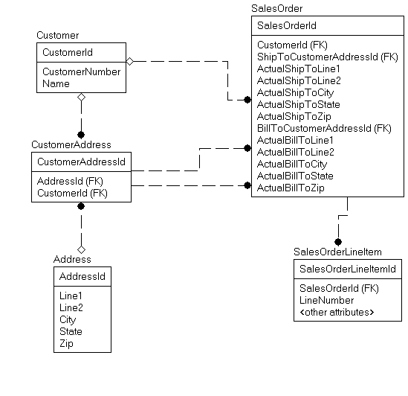
Quiz – Answer “It depends…perhaps both”

Slide 62
Fourth and Fifth Normal Forms
Deals with the relationships within key attributes
In practical terms, it deals when a single row actually has multiple meanings that are not immediately obvious
What makes it challenging that the same table may or may not be in Fourth or Fifth Normal Form depending on subtle differences in requirements
If a table is properly in Third Normal Form, and EFFECTIVELY has no three or more part composite keys, it is already in Fifth Normal Form

Slide 63
Fourth Normal Form
The key of every table should represent no more than one independent multi-valued relationship
In other words, the combination of key attributes should represent one thing only

Slide 64
Is Fourth Normal Form relevant?
A 1992 paper by Margaret S. Wu notes that the teaching of database normalization typically stops short of 4NF, perhaps because of a belief that tables violating 4NF (but meeting all lower normal forms) are rarely encountered in business applications. This belief may not be accurate, however. Wu reports that in a study of forty organizational databases, over 20% contained one or more tables that violated 4NF while meeting all lower normal forms.
http://en.wikipedia.org/wiki/Fourth_normal_form

Slide 65
Fourth Normal Form Example
Requirement: define the classes offered with teacher and book
Dependencies
Class determines Trainer (Based on qualification)
Class determines Book (Based on applicability)
Trainer does not determine Book (or vice versa)
If trainer and book are related (like if teachers had their own specific text,) then this table is in 4NF
Trainer Class Book
========== ============== ================================
Louis Normalization DB Design & Implementation
Chuck Normalization DB Design & Implementation
Fred Implementation DB Design & Implementation
Fred Golf Topics for the Non-Technical

Slide 66
Fourth Normal Form Example
Trainer Class Book
========== ============== ================================
Louis Normalization DB Design & Implementation
Chuck Normalization DB Design & Implementation
Fred Implementation DB Design & Implementation
Fred Golf Topics for the Non-Technical
Question: What classes do we have available and what books do they use?
SELECT DISTINCT Class, Book FROM TrainerClassBook
Class Book
=============== ==========================
Normalization DB Design & Implementation
Implementation DB Design & Implementation
Golf Topics for the Non-Technical
Doing a very slow operation, sorting your data, unnecessarily… please wait

Slide 67
Fourth Normal Form Example
Break Trainer and Book into independent relationship tables to Class
Class Trainer
=============== =================
Normalization Louis
Normalization Chuck
Implementation Fred
Golf Fred
Class Book
=============== ==========================
Normalization DB Design & Implementation
Implementation DB Design & Implementation
Golf Topics for the Non-Technical

Slide 68
Fifth Normal Form
A general rule that breaks out any data redundancy that has not specifically been called out by additional rules
Like Fourth Normal Form, deals with the relationship between key attributes
Basically, if you can break a table with three (or more) independent keys into three individual tables and be guaranteed to get the original table by joining them together, the table is not in Fifth Normal Form
An esoteric rule that is only occasionally violated (but still interesting!)
Examples in hidden slides

Slide 69
Fifth Normal Form Example
Requirement: Store types of cars driver willing to rent
Table is in 5NF if this represents:
Louis is strictly willing to drive any Ford Station Wagon or Hyundai Hatchback
Ted is willing to drive any Coupe from Chevrolet
Because:
Driver determines Car Style
Driver determines Car Brand
Car Brand determines Car Style
Driver determines Car Style and Car Brand
Driver Car Style Car Brand
=================== ======================== ===============
Louis Station Wagon Ford
Louis Hatchback Hyundai
Ted Coupe Chevrolet

Slide 70
Fifth Normal Form Example
Requirement: Store types of cars driver willing to rent
Table is not in 5NF if this represents:
Louis is willing to drive any Station Wagon or Hatchback from Ford or Hyundai
Ted is willing to drive any Coupe from Chevrolet
Still 4th Because:
Driver determines Car Style
Driver determines Car Brand
Car Brand determines Car Style
Driver Car Style Car Brand
=================== ======================== ===============
Louis Station Wagon Ford
Louis Hatchback Hyundai
Ted Coupe Chevrolet

Slide 71
Fifth Normal Form Example
Solution: Three independent tables
Driver Car Style
=================== =======================
Louis Station Wagon
Louis Hatchback
Ted Coupe
Driver Car Brand
=================== =======================
Louis Ford
Louis Hyundai
Ted Chevrolet
Car Style Car Brand
============================= =======================
Station Wagon Ford
Hatchback Hyundai
Coupe Chevrolet

Slide 72
Fifth Normal Form Example
Driver Car Style Car Brand
=================== ======================= ===============
Louis Station Wagon Ford
Louis Hatchback Hyundai
Ted Coupe Chevrolet
Alternative: Table is in 5NF if this represents:
Louis is willing to drive Ford Station Wagons and Hyundai Hatchbacks
Ted is willing to drive a Chevrolet Coupe
Ford only makes (or we only stock) a Station Wagon, Hundai only makes a hatchback and Chevrolet only makes a coupe
Because: Driver determines Car Style + Car Brand
In a well designed system, with these requirements…
The intersection of Style and Brand would have formed it’s own table
Car Style/Car Brand would have been recognized as an independent object with a specific key (often a surrogate).

Slide 73
Book, editor, author
Requirement: Represent books with their authors and editors
Table is in not in 4NF if this represents:
Book “Design” has authors Louis and Jeff and Editor Tony
Book “Golf” has authors Louis and Fred and Editors Steve and Tony
Table is in 5NF if this represents
For book “Design”, Editor Tony edits Louis’ work and Leroy edits Jeff’s work
For book “Golf”, Editor Steve edits Louis’ work, and Tony edits Fred’s work.
Book Author Editor
=================== =================== ===============
Design Louis Tony
Design Jeff Leroy
Golf Louis Steve
Golf Fred Tony

Slide 74
Normal Review
The normal forms should govern the design for the models you create
First Normal Form is for the engine
Even data warehouses are largely in First Normal Form!
BCNF, Fourth, and Fifth are for data consistency
In the end you get a programming surface that is resilient to change and works like SQL Server expects
This isn’t hard stuff!

Slide 75
Can you over-normalize?
Short answer: sort of
Long answer: no
Not matching the design to the user’s needs is not normalization
Breaking objects down beyond user needs is not productive
Lots of joins are not always that costly
Over-normalization is usually over-engineering, ignoring what the user needs

Slide 76
Normalization Final Scan (The Normal way to Normalize)
Columns - One column, one value
Table/row uniqueness – Tables have independent meaning, rows are distinct from one another.
Proper relationships between columns – Columns either are a key or describe something about the row identified by the key.
Data dependent directly on data in the same table, or a foreign key
Scrutinize intra-key dependencies - Make sure relationships between three values in a key. Reduce all relationships to binary relationships if possible.

Slide 77
Normalization is done when..
Data can be used programmatically without parsing
Users have exactly the right number of places to store the data they need
Users stop changing their needs
Pretty much when a system is completely retired
Notes:
[twitter]Usually you are finished normalizing a system when it is replaced… User needs change the requirement constantly @rmtechtrifecta [/twitter]

Slide 78
Denormalization
Stepping back from strict normalization for a good reason
Common reasons
Performance
Usability
But mostly
FUD (Fear, uncertainty, doubt)
Not knowing what normalization is: not denormalization

Slide 79
Denormalization
Adjusting a design that has been normalized in a manner that has caused some level of problem
Usually this is sold as having to do with performance or usability
Common saying
Normalize ‘til it hurts, Denormalize ‘til it works
Normalize ‘til it works.
In reality, there is very little reason to denormalize when Normalization has been done based on requirements and user need.
There are common exceptions…

Slide 80
Typically acceptable denormalization
When read/write ratio approaches infinity
Examples
Balances/Inventory as of a certain date (summing activity after that date for totals)
Allows you to query a LOT LESS data
Calendar table
November 15, 2006 with always be a Wednesday
Table of integers
Prime Numbers
Odd Numbers

Slide 81
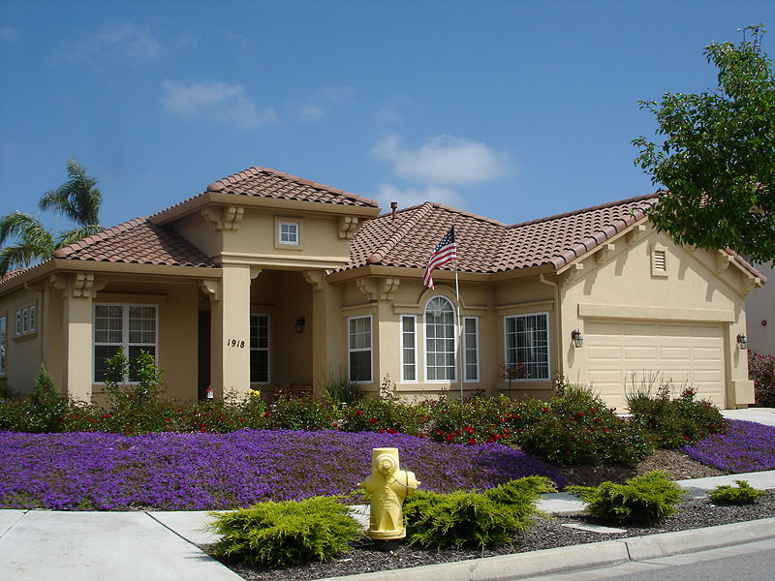
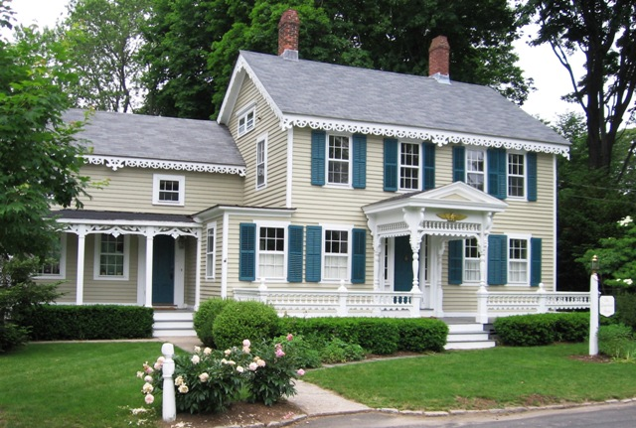
Final Exam: Data Model For a House
A company needs a database to model houses on a block
Unless I tell you what the company does, you will not get the answer right… Perspective is everything!

Slide 82
“Daydream” Practice
A good way to get better is to pick out scenarios in real life and mentally model them
Such as:
Grocery list management
DMV
Theme park operations
Build models in your spare time to reinforce your daydreams and your modeling skills
Warning: telling non-nerdy people you do this will open you up to teasing.

Slide 83
So you have a design…build!
I usually build to a SQL Server that contains model databases
Strongly consider using SQL Server to implement checks, domains, constraints on what can be entered
Minimally, make certain that the data is protected at a level lower than a user can get access
Ideally:
You should trust that your data is valid to the immutable business rules at all times
The only data cleansing you should ever do is to look for users doing dumb stuff

Slide 84
Test…test…test
Start building unit tests in during conceptual modeling that you can run to make sure that your design works
Remember the requirements? Develop the test plan directly from them
Throw tons of bad data at the design, especially places where you thought data should have been designed better
Try to get an error for every constraint implemented
Try to get an error for every constraint NOT implemented

Slide 85

Q&A
Kevin Kline
kkline@sentryone.com
https://twitter.com/kekline
Don’t forget to download Plan Explorer https://sentryone.com/plan-explorer, plus the Plan Explorer plug-in for ADS
Connect with us on social media.
Cloud migration projects, SSIS and PowerBI consulting, and much more from PragmaticWorks!
Talk to a SentryOne expert. Use our 3-Step process to solve your most difficult SQL Server performance issues!
Louis Davidson
louis@drsql.org
http://twitter.com/drsql

Slide 86
Thank you!

